Slide 1
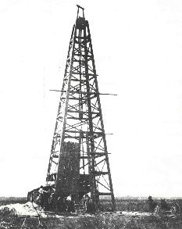
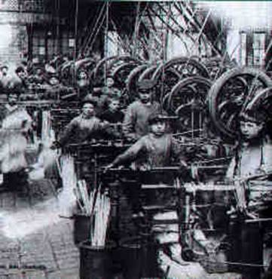
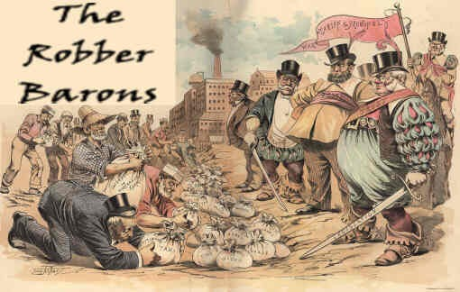
Industry Comes of Age 1865-1900

Slide 2
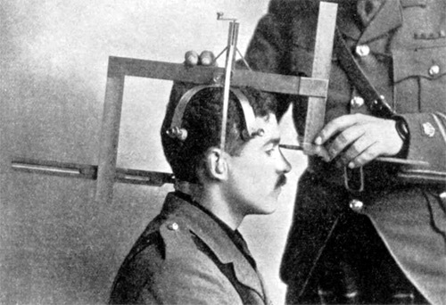
The Gospel of Wealth
Many of the newly rich had worked from poverty to wealth, and thus felt that some people in the world were destined to become rich and then help society with their money. This was the “Gospel of Wealth.”
“Social Darwinism” applied Charles Darwin’s survival-of-the-fittest theories to business. It said the reason a Carnegie was at the top of the steel industry was that he was most fit to run such a business.

Slide 3
Sec 1. Intro
Time Period
1869-1900
Key Names
Andrew Carnegie, Edwin L. Drake, Thomas Edison, Alexander Bell, Christopher Sholes
Key Terms
Bessemer Process,Industrialization

Slide 4
Sec. 1 Industry Spurs Change
Pattillo Higgins
Great Texas Oil Boom- Perseverance
Natural Resources Fuel Industrialization
Black Gold
Native Americans used as fuel
Titusville, Pennsylvania- Edwin L. Drake
Kerosene- Gasoline thow away
Bessemer Steel Process
Injecting Air into Molten Iron to clean out impurities
Open-Hearth
New Uses For Steel
Railroads, Farm Machines, Brooklyn Bridge, Sky Scraper

Slide 5
Sec. 1 Industry Spurs Change
Inventions Promote Change
Power of Electricity
Thomas Edison- 1880
Harness Electricity
Business Growth, Business Placement, Business Production
Inventions Change Lifestyles
Christopher Sholes
Typewriter-1867
Alexander Graham Bell
Telephone-1876
Impact- Women join work force, Workers lives improved, less labor

Slide 6
Sec. 2 The Age of Railroads
Railroads Span Time and Space
Government made loans to develop railroads. WHY?
Video
A National Network
Completed in 1869
5 Transcontinental Railroads by 1893
Romance and Reality
Public- new starts, land, adventure
Workers- CP=Chinese, UP=Irish
2,000 killed, 20,000 injured
Railroad Time
Sun directly overhead=Noon
C.F. Dowd Proposed 24 worldwide time zones

Slide 7
Sec. 2 The Age of Railroads
Opportunities and Opportunists
New Towns and Markets
Cities grew along the tracks-Flagstaff, Seattle, Denver
Cities specialized in markets
George Pullman
Produced sleeper cars for trains
Built a city for his workers near factory- strict but luxury conditions
Credit Mobilier
Company used to embezzle money by Union Pacific
Paid congress to look other way
James Garfield- Republican Party

Slide 8
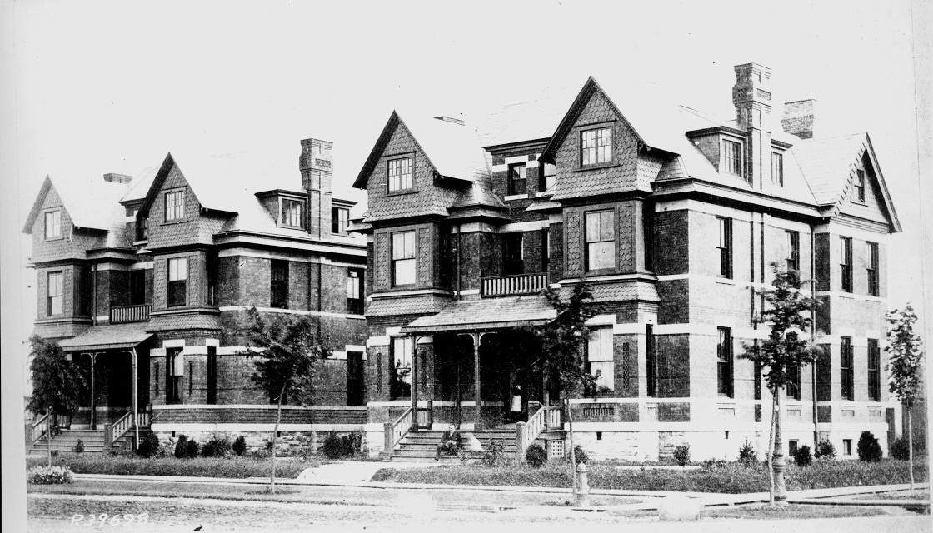
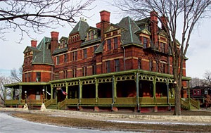
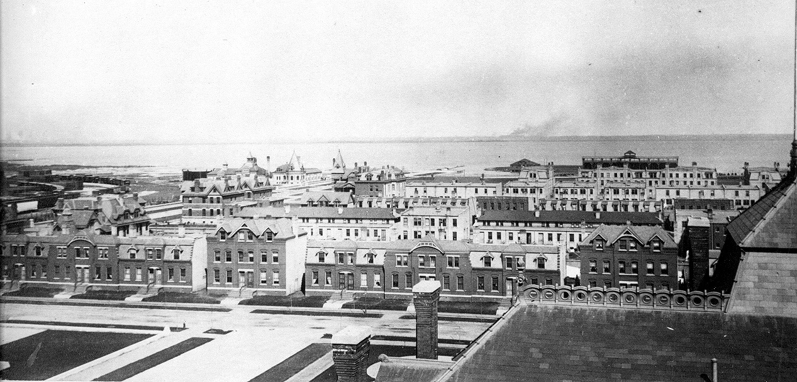
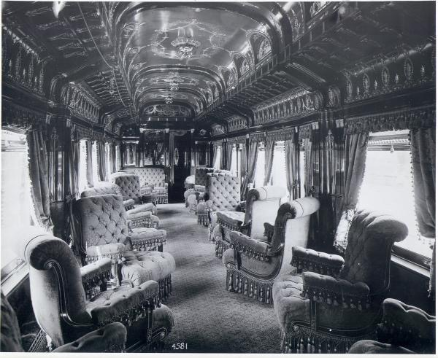

Slide 9
Sec. 2 The Age of Railroads
The Grange and the Railroads
Railroad Abuse
Sold land to businesses, Fixed prices, over charges
Granger Laws
Munn v. Illinois
States regulate prices to benefit consumers & farmers
Interstate Commerce Act
States could not regulate interstate commerce
Panic and Consolidation
Corporate abuse, mismanagement, competition, & overbuilding
J.P.Morgan and Company bought and controlled over 2/3 of the nations railroads.

Slide 10
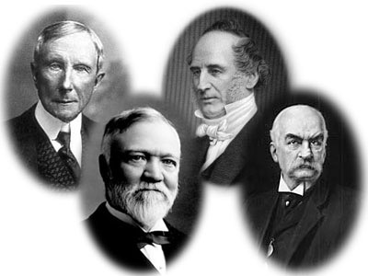
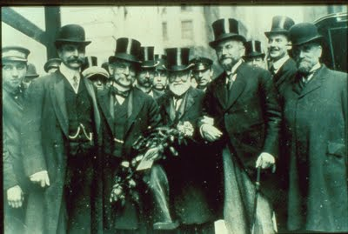
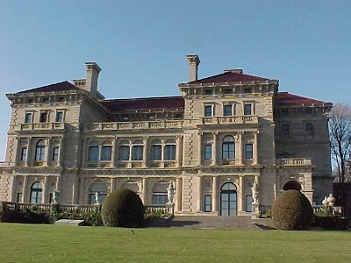
Captains of Industry or Robber Barons?

Slide 11
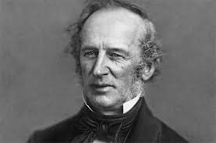
The Commodore
Cornelius Vanderbilt turn from steam ship owner to a railroad industry tycoon.
Came to power by buying out competitors
Many rivals in railroads
Shipping contract with Rockefeller established his business for longevity.

Slide 12
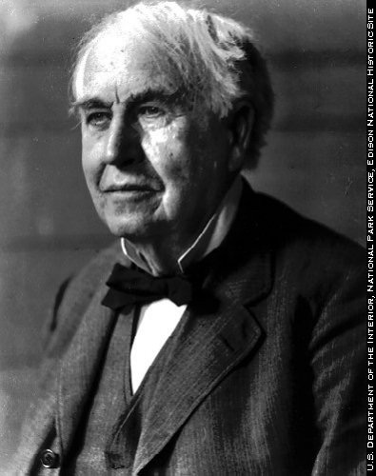
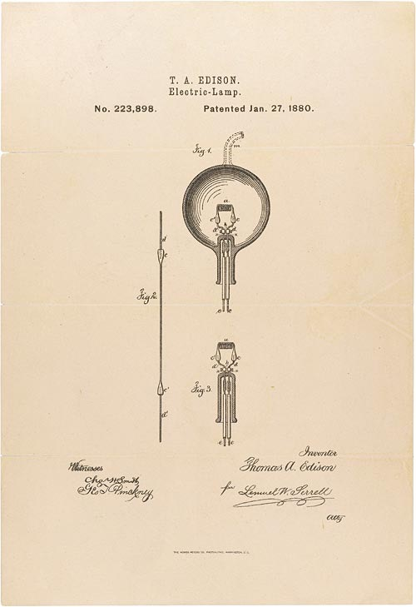
Miracles of Mechanization American ingenuity played a vital role
Popular inventions included the cash register, the stock ticker, the typewriter, the refrigerator car, the electric dynamo, and the electric railway, which displaced animal-drawn cars.
Thomas Edison, the “Wizard of Menlo Park,” was the most versatile inventor, who, while best known for his electric light bulb, also cranked out scores of other inventions.

Slide 13
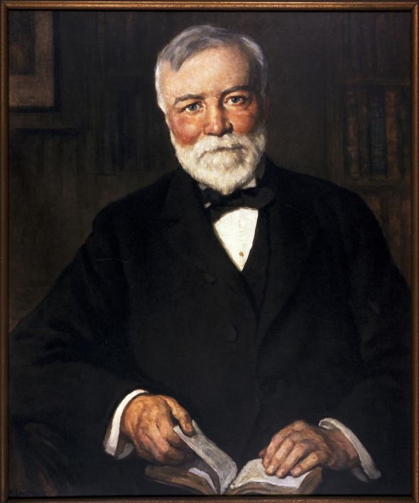
The Trust Titan Emerges
Industry giants used various ways to eliminate competition and maximize profits.
Andrew Carnegie used a method called “vertical integration,” which meant that he bought out and controlled all aspects of an industry (in his case, he mined the iron, transported it, refined it, and turned it into steel, controlling all parts of the process).

Slide 14
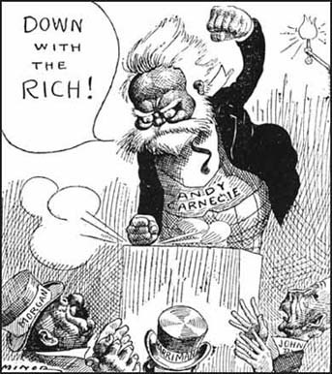
Carnegie and Other Sultans of Steel
Andrew Carnegie started off as a poor boy in a bad job, but by working hard, assuming responsibility, and charming influential people, he worked his way up to wealth.
He started in the Pittsburgh area, but he was not a man who liked trusts; still, by 1900, he was producing 1/4 of the nation’s Bessemer steel, and getting $25 million a year.
J. Pierpont Morgan, having already made a fortune in the banking industry and in Wall Street, was ready to step into the steel tubing industry, but Carnegie threatened to ruin him, so after some tense negotiation, Morgan bought Carnegie’s entire business at $400 million (this was before income tax).
But Carnegie, fearing ridicule for possessing so much money, spent the rest of his life donating $350 million of it to charity, pensions, and libraries.
Meanwhile, Morgan took Carnegie’s holdings, added others, and launched the United States Steel Corporation in 1901, a company that became the world’s first billion-dollar corporation (it was capitalized at $1.4 billion).

Slide 15
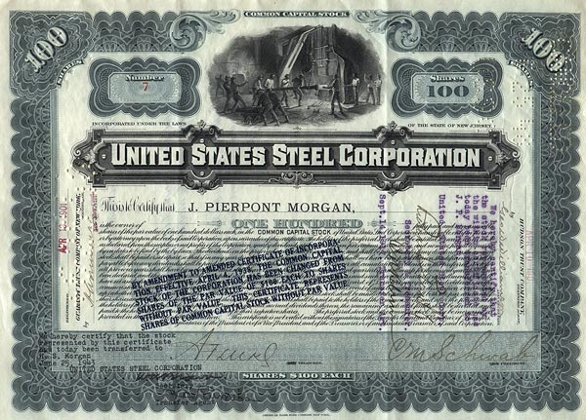
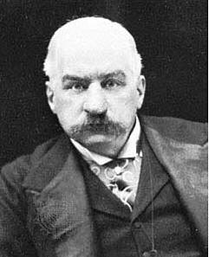
J.P. Morgan and U.S. Steel
Meanwhile, J.P. Morgan took Carnegie’s holdings, added others, and launched the United States Steel Corporation in 1901, a company that became the world’s first billion-dollar corporation (it was capitalized at $1.4 billion).
J.P. Morgan also placed his own men on the boards of directors of other rival competitors to gain influence there and reduce competition, a process called “interlocking directorates.”
“A man generally has two reasons for doing a thing. One that sounds good, and a real one.“ Mr. Morgan

Slide 16
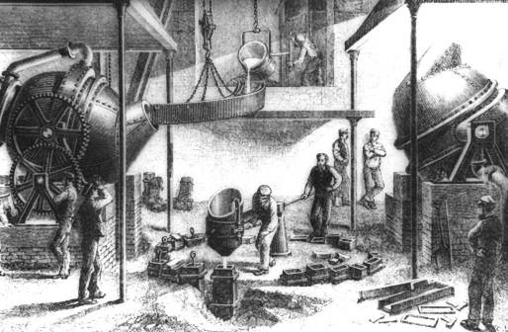
The Supremacy of Steel
In Lincoln’s day, steel was very scarce and expensive, but by 1900, Americans produced as much steel as England and Germany combined.
This was due to an invention that made steel-making cheaper and much more effective: the Bessemer process, which was named after an English inventor even though an American, William Kelly, had discovered it first:
Cold air blown on red-hot iron burned carbon deposits and purified it.
America was one of the few nations that had a lot of coal for fuel, iron for smelting, and other essential ingredients for steel making, and thus, quickly became #1.

Slide 17
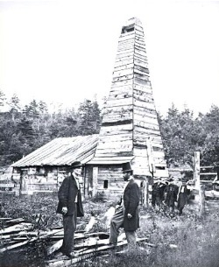
Rockefeller Grows an American Beauty Rose
In 1859, a man named Drake first used oil to get money, and by the 1870s, kerosene, a type of oil, was used to light lamps all over the nation.
However, by 1885, 250,000 of Edison’s electric light bulbs were in use, and the electric industry soon rendered kerosene obsolete, just as kerosene had made whale oil obsolete.
Oil, however, was just beginning with the gasoline-burning internal combustion engine.
Drake First
Oil Well

Slide 18
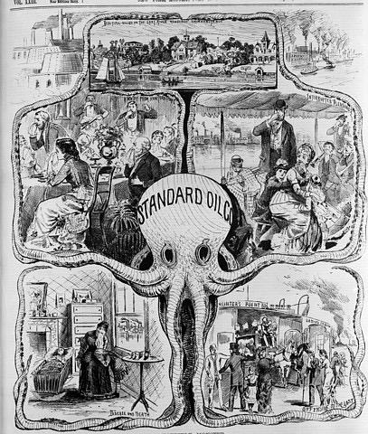
Standard Oil and Mr. Rockefeller
John D. Rockefeller, ruthless and merciless, organized the Standard Oil Company of Ohio in 1882 (five years earlier, he had already controlled 95% of all the oil refineries in the country).
John D. Rockefeller, master of “horizontal integration,” simply allied with or bought out competitors to monopolize a given market.
He used this method to form Standard Oil and control the oil industry by forcing weaker competitors to go bankrupt.

Slide 19
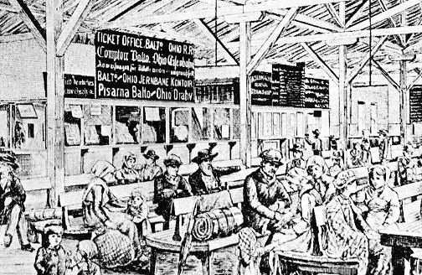
The Impact of the Industrial Revolution on America
As the Industrial Revolution spread in America, the standard of living rose, immigrants swarmed to the U.S., and early Jeffersonian ideals about the dominance of agriculture fell.
A nation of farmers was becoming a nation of wage earners, but the fear of unemployment was never far, and the illness of a breadwinner (the main wage owner) in a family was disastrous.
Strong pressures in foreign trade developed as the tireless industrial machine threatened to flood the domestic market.

Slide 20
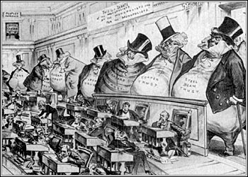
Sherman Anti-Trust Act
In 1890, the Sherman Anti-Trust Act was signed into law; it forbade combinations (trusts, pools, interlocking directorates, holding companies) in restraint of trade, without any distinction between “good” and “bad” trusts.
It proved ineffective, however, because it couldn’t be enforced.
Not until 1914 was it properly enforced and those prosecuted for violating the law were actually punished.

Slide 21
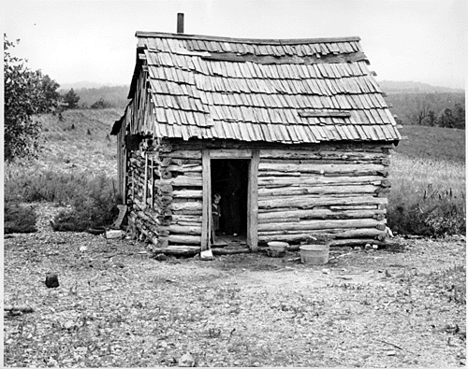
The South in the Age of Industry
The South remained agrarian despite all the industrial advances
However, cheap labor led to the creation of many jobs, and despite poor wages, many white Southerners saw employment as a blessing.
Blacks were largely sharecroppers
Sharecropper shack

Slide 22
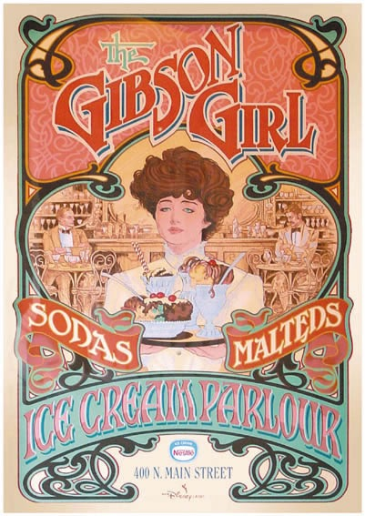
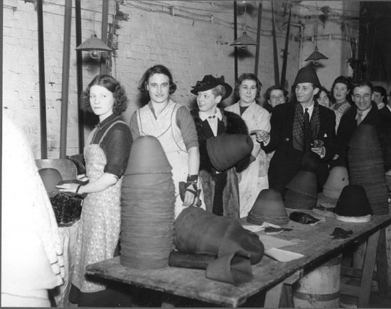
Women in the Age of Industrialism
Women, who had swarmed to factories and had been encouraged by recent inventions, found new opportunities, and the “Gibson Girl,” created by Charles Dana Gibson, became the romantic ideal of the age.
The Gibson Girl was young, athletic, attractive, and outdoorsy (not the stay-at-home mom type).
However, many women never achieved this, and instead toiled in hard work because they had to do so in order to earn money.

