Slide 1
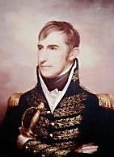
Battle of Tippecanoe, 1811
General William Henry Harrison → governor of the Indiana Territory.
Invited Native Indian chiefs to Ft. Wayne, IN to sign away 3 mil. acres of land to the US government.
Tecumseh organized a confederacy of Indian tribes to fight for their homelands.
Tecumseh’s brother fought against Harrison and was defeated at Tippecanoe.
This made Harrison a national hero! [1840 election → Tippecanoe & Tyler, too!]

Slide 2
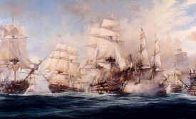
Causes for the War of 1812
The British Navy is taking American sailors from American ships to sail on British ships. This is called impressment.
British sailors leave British ships to sail on American ships because they are treated better and get paid very well

Slide 3
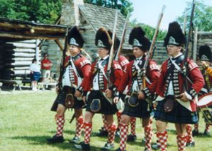
Causes for the War of 1812
The United States has a desire to expand into more territory like British Canada
The real cause for this land grab is because of a poor transportation system and effects from the Embargo Act
Americans believe that seizing more land will end the depression

Slide 4
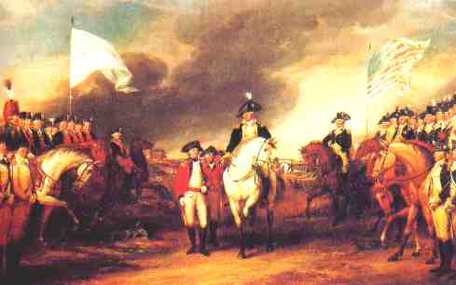
Causes for the War of 1812
The United States wants to prove to Britain that the victory of the American Revolution was not luck.
Americans demand respect from the world.

Slide 5
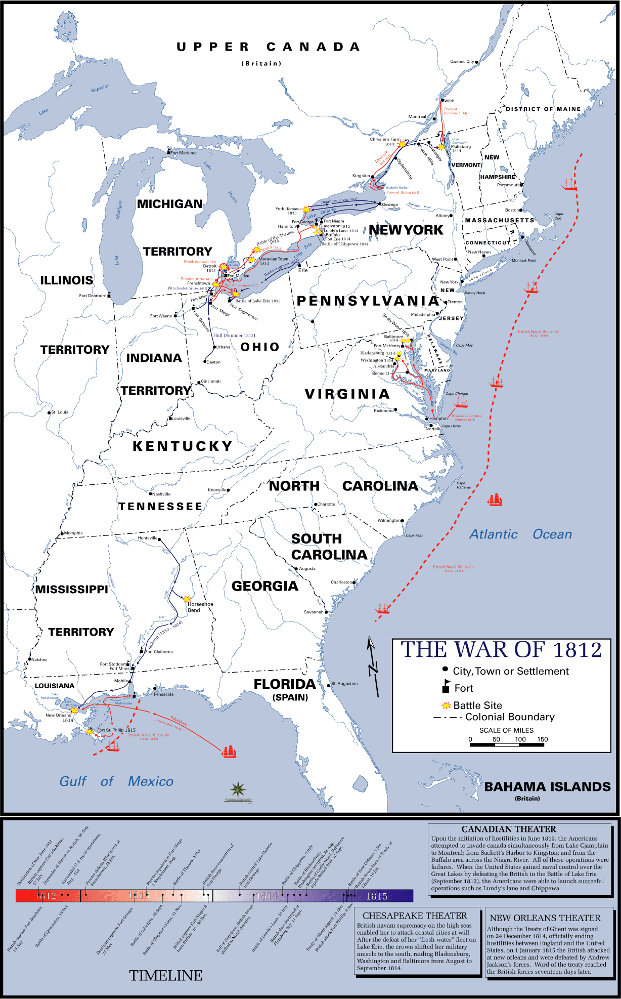
Overview of the War of 1812

Slide 6
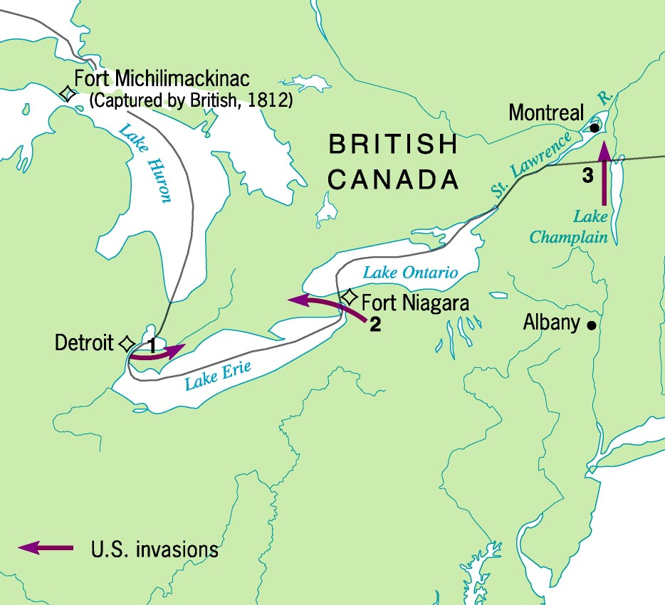
3 U. S. Invasions of 1812

Slide 7
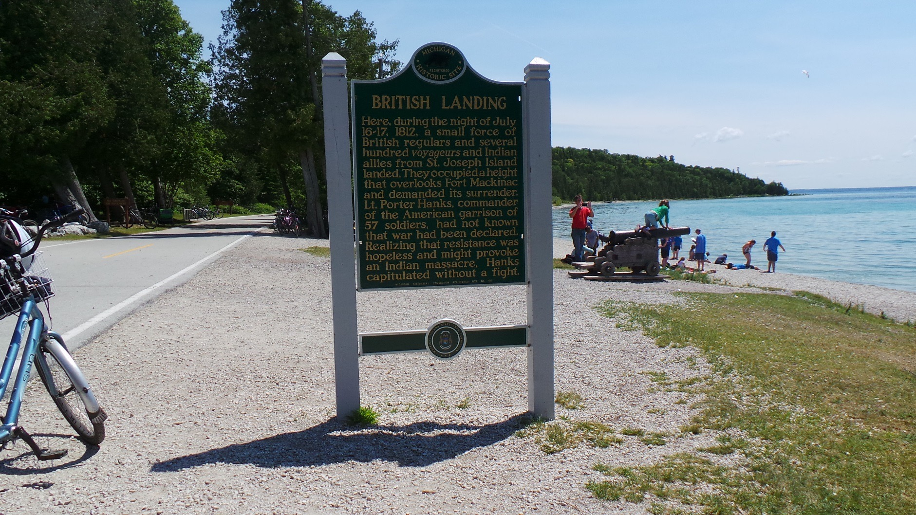
Battle of Mackinac

Slide 8
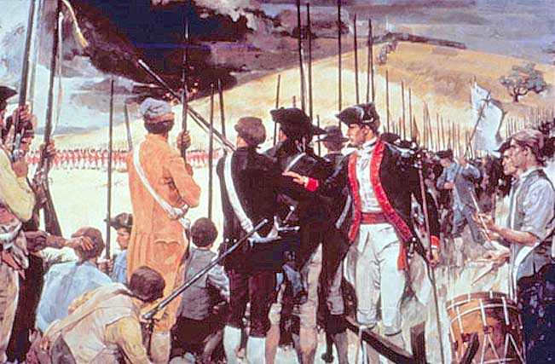
The British Burn the Capital
August 1814, the British Army invades the United States and marches on Washington D.C.
After a brief fight the city surrenders and nearly all government buildings are razed by fire
Madison rallies the American public after this defeat

Slide 9
“The Star Spangled Banner”
Francis Scott Key, a Lawyer on a British barge witnessed the British bombardment of Fort McHenry, near Baltimore for 12 hours
In the morning he observed that the American flag still flew over the fort and writes a poem called “The Defence of Ft McHenry” it eventually becomes a song “The Star Spangled Banner”
Americans rally to the war effort after the capital is burnt down

Slide 10
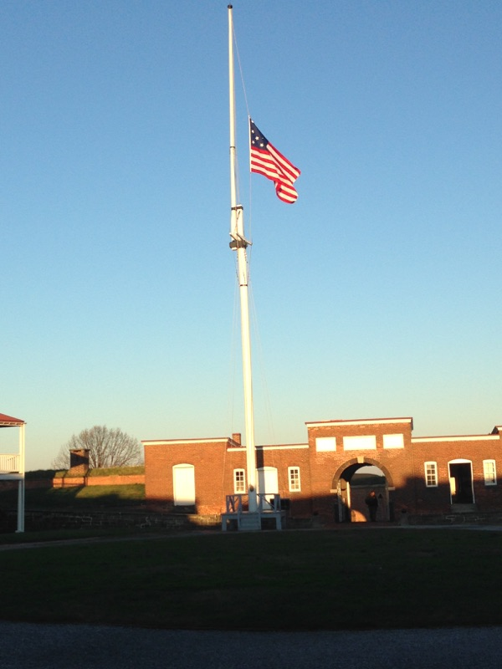
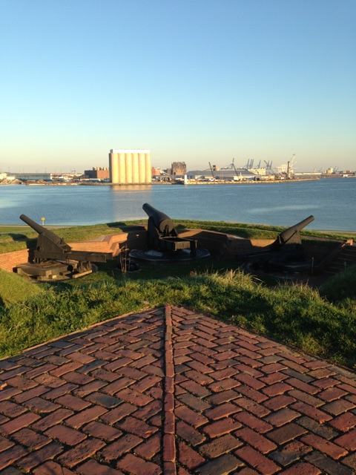
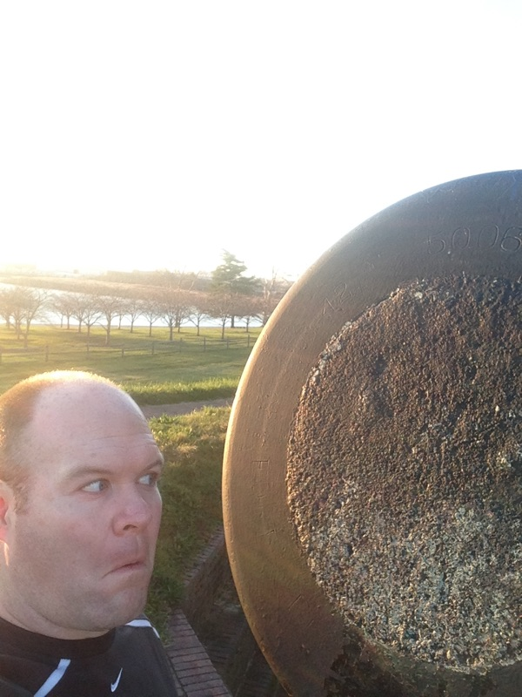
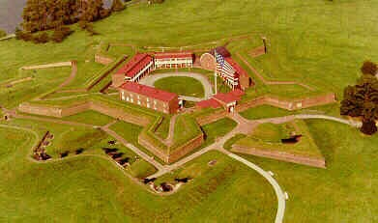
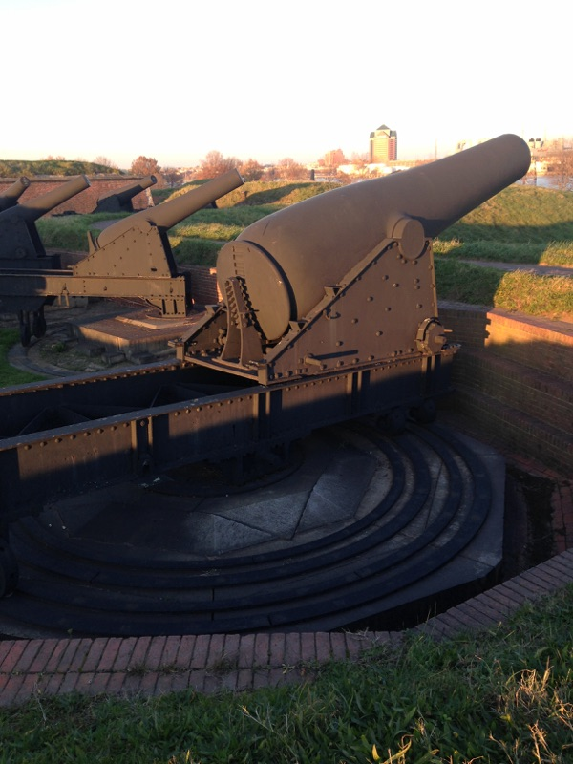
“The Star Spangled Banner”

Slide 11
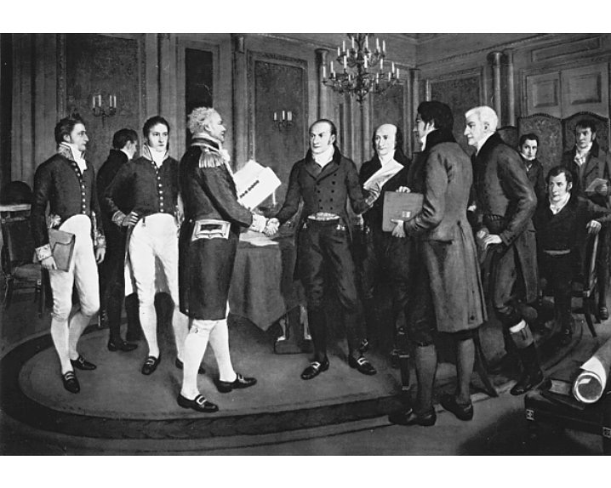
Things that make you go hmmm
The Treaty of Ghent on December 24, 1814 ends the War of 1812. The war is considered Staus quo ante bellum
The Hartford Convention, several New England states fear that the war is lost and actually talk about becoming another country

Slide 12
TREATY OF GHENT BRINGS PEACE

Slide 13
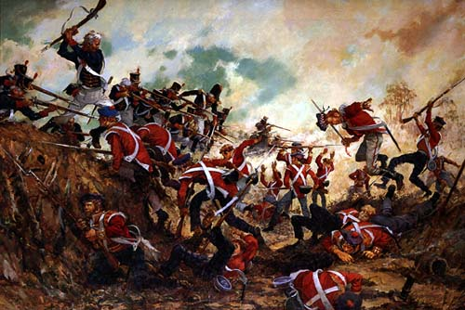
The Battle of New Orleans
The American forces are a multicultural motely band of experienced soldiers and warriors
The British, a trained army are virtually mauled by American forces hiding behind earthworks and cannons

Slide 14
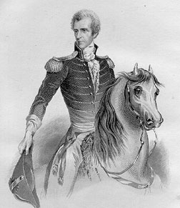
The Battle of New Orleans
American forces at New Orleans are led by General Andrew Jackson whose army inflicts great casualties on the British army
Andrew Jackson will be associated with winning the war. People assume that this victory is responsible for ending the war.

Slide 15
The Battle of New Orleans

Slide 16
The Impact of the War of 1812
A sense of nationalism sweeps America. Nationalism is a belief and sense of pride in one’s country based on it’s achievements.
The nation will embark on foreign trade and begin to build a transportation system in the United States.
Native American resistance will be removed from the Ohio River Valley permanently opening the Midwest for expansion.

